Slide 1
Acids Base Reactions- II
Dr. Semanti Basu
Assistant Professor
Department of Chemistry
Bejoy Narayan Mahavidyalaya Itachuna, Hooghly, W.B., India

Slide 2
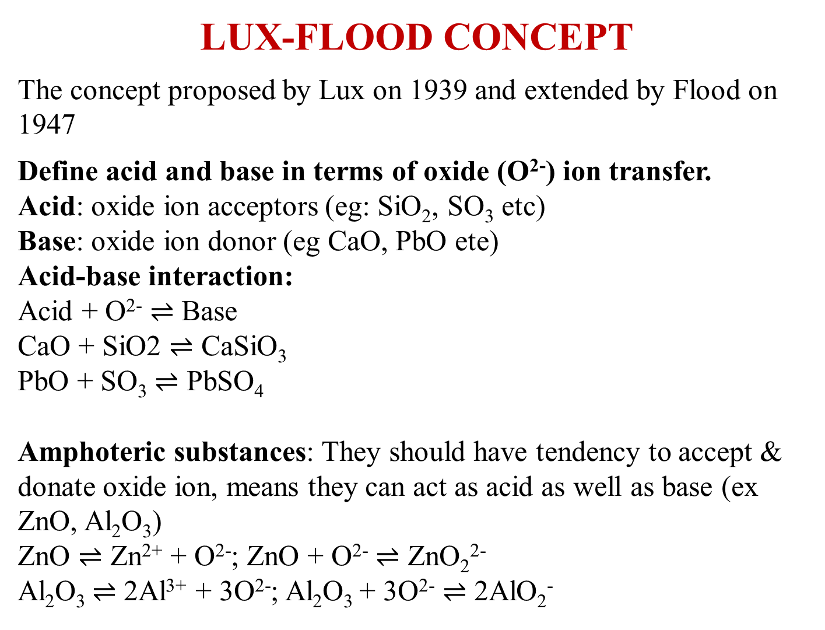
LUX-FLOOD CONCEPT
The concept proposed by Lux on 1939 and extended by Flood on 1947
Define acid and base in terms of oxide (O²⁻) ion transfer.
Acid: oxide ion acceptors (eg: SiO₂, SO₃ etc)
Base: oxide ion donor (eg CaO, PbO ete)
Acid-base interaction:
Acid + O²⁻ $⇌$ Base
CaO + SiO2 $⇌$ CaSiO₃
PbO + SO₃ $⇌$ PbSO₄
Amphoteric substances: They should have tendency to accept & donate oxide ion, means they can act as acid as well as base (ex ZnO, Al₂O₃)
ZnO $⇌$ Zn²⁺ + O²⁻; ZnO + O²⁻ $⇌$ ZnO₂²⁻
Al₂O₃ $⇌$ 2Al³⁺ + 3O²⁻; Al₂O₃ + 3O²⁻ $⇌$ 2AlO₂⁻

Slide 3
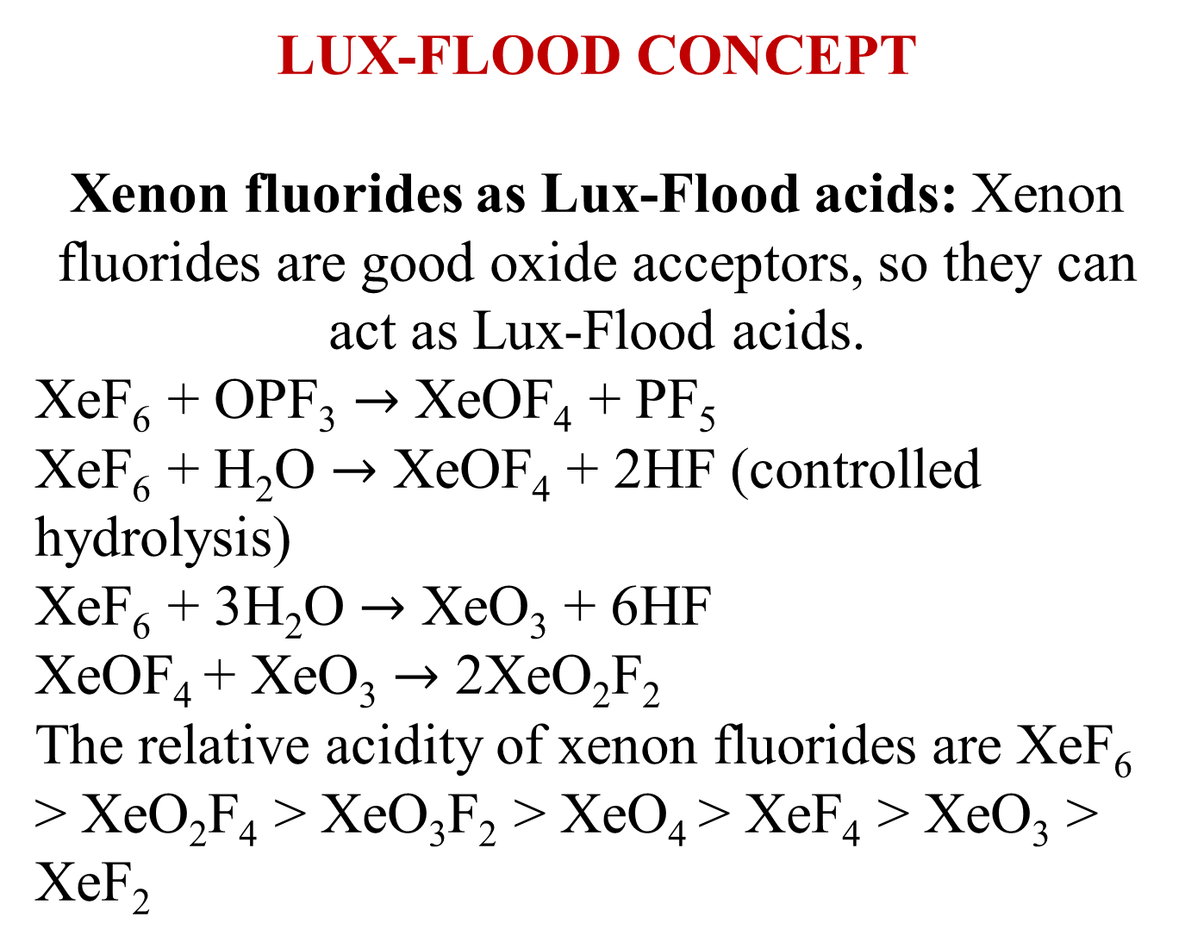
LUX-FLOOD CONCEPT
Xenon fluorides as Lux-Flood acids: Xenon fluorides are good oxide acceptors, so they can act as Lux-Flood acids.
XeF₆ + OPF₃ $→$ XeOF₄ + PF₅
XeF₆ + H₂O $→$ XeOF₄ + 2HF (controlled hydrolysis)
XeF₆ + 3H₂O $→$ XeO₃ + 6HF
XeOF₄ + XeO₃ $→$ 2XeO₂F₂
The relative acidity of xenon fluorides are XeF₆ > XeO₂F₄ > XeO₃F₂ > XeO₄ > XeF₄ > XeO₃ > XeF₂

Slide 4
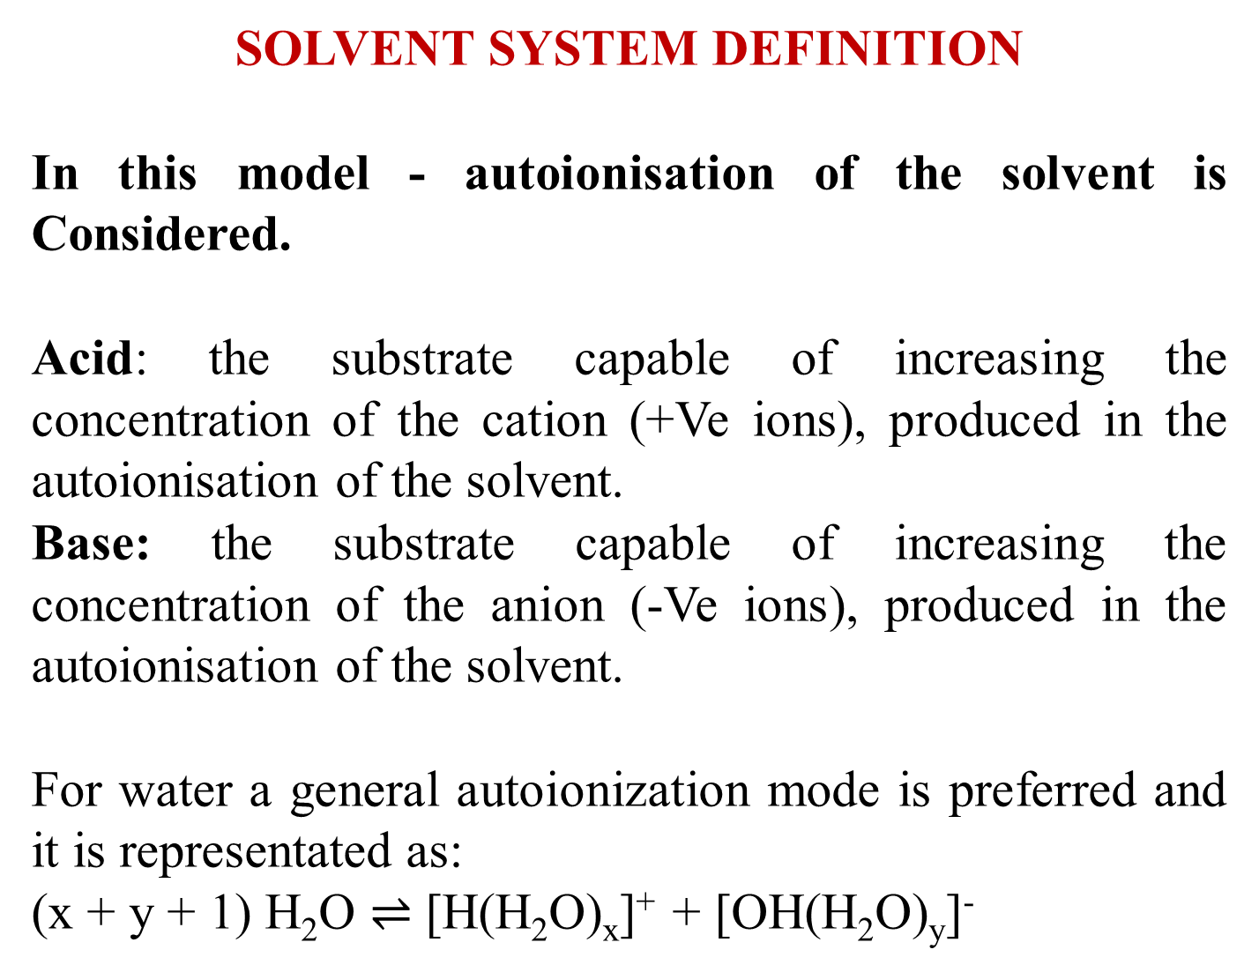
SOLVENT SYSTEM DEFINITION
In this model - autoionisation of the solvent is Considered.
Acid: the substrate capable of increasing the concentration of the cation (+Ve ions), produced in the autoionisation of the solvent.
Base: the substrate capable of increasing the concentration of the anion (-Ve ions), produced in the autoionisation of the solvent.
For water a general autoionization mode is preferred and it is representated as:
(x + y + 1) H₂O $⇌$ [H(H₂O)_{x}]⁺ + [OH(H₂O)_{y}]⁻

Slide 5
SOLVENT SYSTEM DEFINITION
Classification of solvents
Depending upon the proton donor and proton acceptor properties the solvents are classified as follows.
2. Depending upon solvation property (‘like dissolves like’), solvents are of two types:
(i) ionizing solvent means polar or ionic solvent:
(ii) Non-ionising solvents.
3. Another classification is aqueous and non-aqueous solvents.

Slide 6
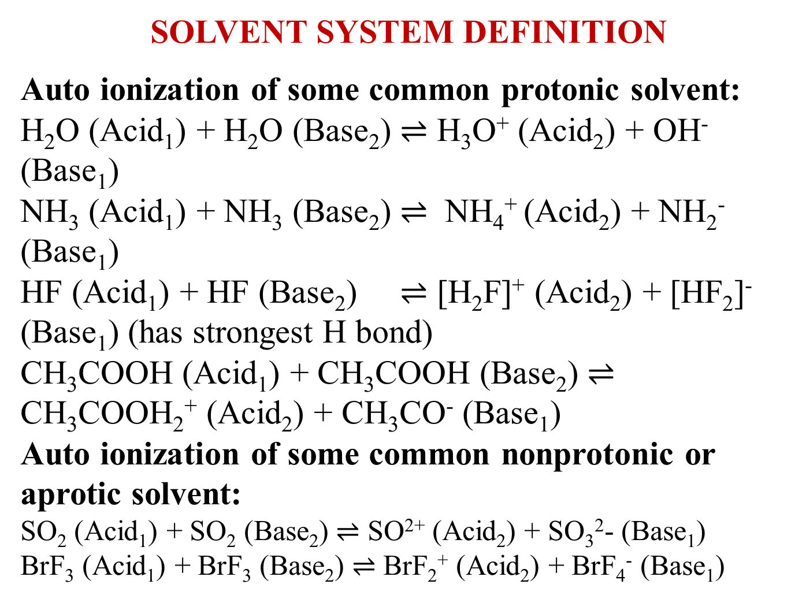
SOLVENT SYSTEM DEFINITION
Auto ionization of some common protonic solvent:
H₂O (Acid₁) + H₂O (Base₂) $⇌$ H₃O⁺ (Acid₂) + OH⁻ (Base₁)
NH₃ (Acid₁) + NH₃ (Base₂) $⇌$ NH₄⁺ (Acid₂) + NH₂⁻ (Base₁)
HF (Acid₁) + HF (Base₂) $⇌$ [H₂F]⁺ (Acid₂) + [HF₂]⁻ (Base₁) (has strongest H bond)
CH₃COOH (Acid₁) + CH₃COOH (Base₂) $⇌$ CH₃COOH₂⁺ (Acid₂) + CH₃CO⁻ (Base₁)
Auto ionization of some common nonprotonic or aprotic solvent:
SO₂ (Acid₁) + SO₂ (Base₂) $⇌$ SO²⁺ (Acid₂) + SO₃²- (Base₁)
BrF₃ (Acid₁) + BrF₃ (Base₂) $⇌$ BrF₂⁺ (Acid₂) + BrF₄⁻ (Base₁)

Slide 7
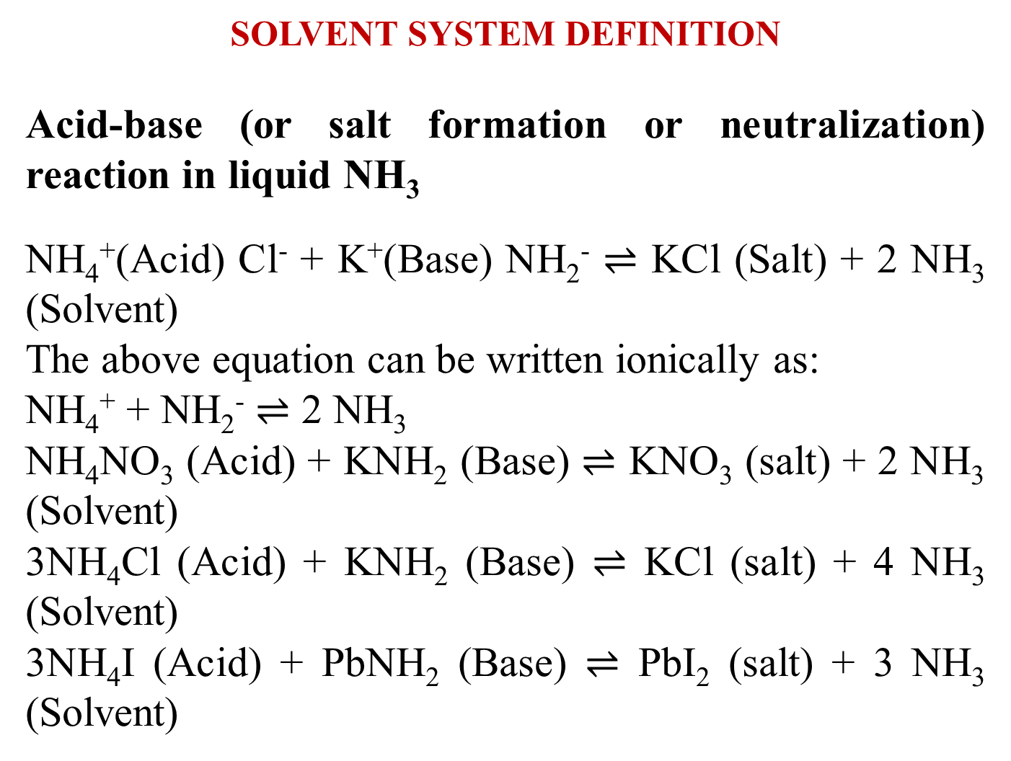
SOLVENT SYSTEM DEFINITION
Acid-base (or salt formation or neutralization) reaction in liquid NH₃
NH₄⁺(Acid) Cl⁻ + K⁺(Base) NH₂⁻ $⇌$ KCl (Salt) + 2 NH₃ (Solvent)
The above equation can be written ionically as:
NH₄⁺ + NH₂⁻ $⇌$ 2 NH₃
NH₄NO₃ (Acid) + KNH₂ (Base) $⇌$ KNO₃ (salt) + 2 NH₃ (Solvent)
3NH₄Cl (Acid) + KNH₂ (Base) $⇌$ KCl (salt) + 4 NH₃ (Solvent)
3NH₄I (Acid) + PbNH₂ (Base) $⇌$ PbI₂ (salt) + 3 NH₃ (Solvent)

Slide 8
SOLVENT SYSTEM DEFINITION
Limitations Solvent System Concept
The definition of acids and bases is based on the nature of the solvent cation and solvent anion obtained by auto-ionization of the solvent.
Acid base reaction taking place in the absence of a solvent can’t be explained.
The concept can’t account for the acid-base reaction occurring in non-ionizing solvents like C₆H₆, CHCl₃

Slide 9
USANOVICH CONCEPT (1934)
This concept extends and generalises the idea of Lewis acid-base concept. It does not get confined within the domain of electron pair donation and acceptance. According to this definition
Acid: A substance capable of accepting anions or electrons or giving up cations, and a base is a substance which can combine with the cations or give up anions or electrons.
Base: A substance which combines with cations or give up anions or electrons.
Thus the redox reactions (i.e. electron transfer reactions) are also regarded as acid-base reactions.
Both the Lewis and Unsanovich concepts are identical in terms of kind but they may differ on the degree of the process.
In Lewis acid-base interactions, the donated electron pair is commonly shared by the reactants in the adduct but in Usanovich concept, the electrons might by completely or partially transferred.

Slide 10
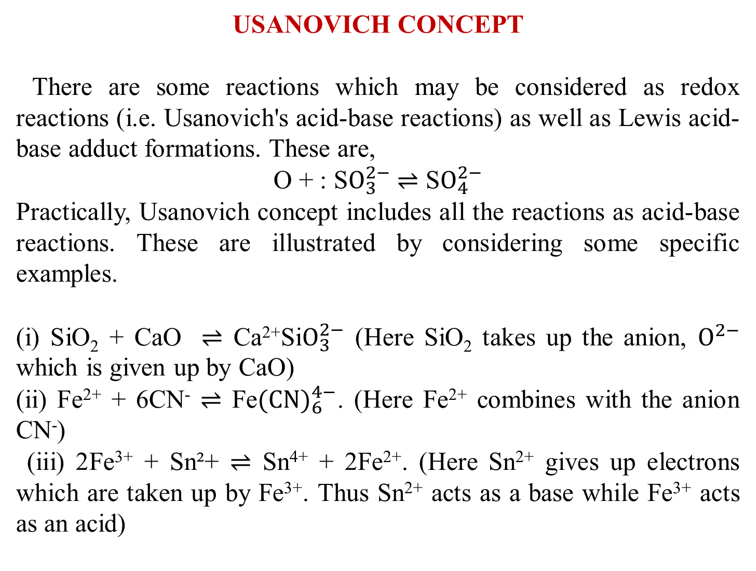
USANOVICH CONCEPT
There are some reactions which may be considered as redox reactions (i.e. Usanovich's acid-base reactions) as well as Lewis acid-base adduct formations. These are,
O + : S$O_{3}^{2−}$ $⇌$ S$O_{4}^{2−}$
Practically, Usanovich concept includes all the reactions as acid-base reactions. These are illustrated by considering some specific examples.
(i) SiO₂ + CaO $⇌$ Ca²⁺Si$O_{3}^{2−}$ (Here SiO₂ takes up the anion, $O^{2−}$ which is given up by CaO)
(ii) Fe²⁺ + 6CN⁻ $⇌$ Fe${(CN)}_{6}^{4−}$. (Here Fe²⁺ combines with the anion CN⁻)
(iii) 2Fe³⁺ + Sn²+ $⇌$ Sn⁴⁺ + 2Fe²⁺. (Here Sn²⁺ gives up electrons which are taken up by Fe³⁺. Thus Sn²⁺ acts as a base while Fe³⁺ acts as an acid)

Slide 11

USANOVICH CONCEPT
Merits of the concept: It can extend the concept of acid-base interaction in both protic and aprotic solvents.
Demerits of the concept:
(1) It pays an excessive attention to the idea of autoionisation of the solvents ignoring the other physical and chemical properties of the solvents. It even ignores the properties arising from the dielectric constant which in fact, determines the possibility of autoionisation. In SO₂ SOCl₂ has been regarded as an acid and the reaction between SOCl₂ and Na₂SO₃ has been treated as an acid-base neutralisation reaction. But unfortunately, there is no convincing evidence in favour of the existence of SO²⁺ ion in liquid SO₂. If SOCl2 is added in *SO₂ (in which the sulfur site is tagged) then it is expected that the exchange between the tagged an untagged sulfur would occur as follows:
2*SO₂ $⇌$ *SO²⁺ + *S$O_{3}^{2−}$ ; SOCl₂ $⇌$ SO²⁺ + 2C$l^{−}$;
SO²⁺ + *S$O_{3}^{2−}$ $⇌$ SO₂+ *SO₂; *SO²⁺ + 2C$l^{−}⇌$ *SOCl₂
But unfortunately, no such exchange is noticed. It questions the validity of the mode ionisation as shown above.
Physically, for the solvent like SO₂ having a low dielectric constant ($Ɛ$= 15.6 $Ɛ$₀), the autoionisation leading to the highly charged ionic species is highly unlikely. Thus the solver concept appears tenable only for the solvents having very high dielectric constants (e.g.
H₂O = 80).
(ii) It cannot explain many acid-base reactions occurring in the absence of any solvent.
(iii) Many acid-base reactions involving the neutral molecules cannot be explained in this model.

Slide 12
A GENERALISED CONCEPT OF ACIDS AND BASES
All the theories basically sound the same fundamental tone. An acid is defined as a positive ion (which may be a proton or the cation of the autoionised products of the solvent) donor or the acceptor of a negative ion (which may be simple electron(s) or electron pair or anions). Similarly, a base is defined as a negative ion donor or as a positive ion acceptor.
Thus we can conclude that the positive character of a species measures its acid function and it decreases in a reaction with a base, while the negative character of a species characterises its basic function which decrease in a reaction with an acid. Thus the species having the highest positive charge density is the strongest acid while the species having the highest negative charge density is the strongest base.

Slide 13
CONCEPT OF ULTIMATE ACIDS AND BASES
The acidic or basic function can be interpreted in terms of positive or negative charge reacting site under consideration. Hence, the species having the highest positive charge density is definitely the strongest acid. Thus the proton appears to be the strongest one. But the bare proton never exists. It is too strong to coexist without interacting with a substance having some electron cloud. It can interact even with the weakest base like the noble gas atom. Thus the protons are considered as the ultimate acids. Similarly, the species having the highest negative charge density is the strongest base. Apparently, the bare electron i.e. the complement of the proton is the ultimate base. Though free electron can’t exist, solvated electron can exist.

Slide 14
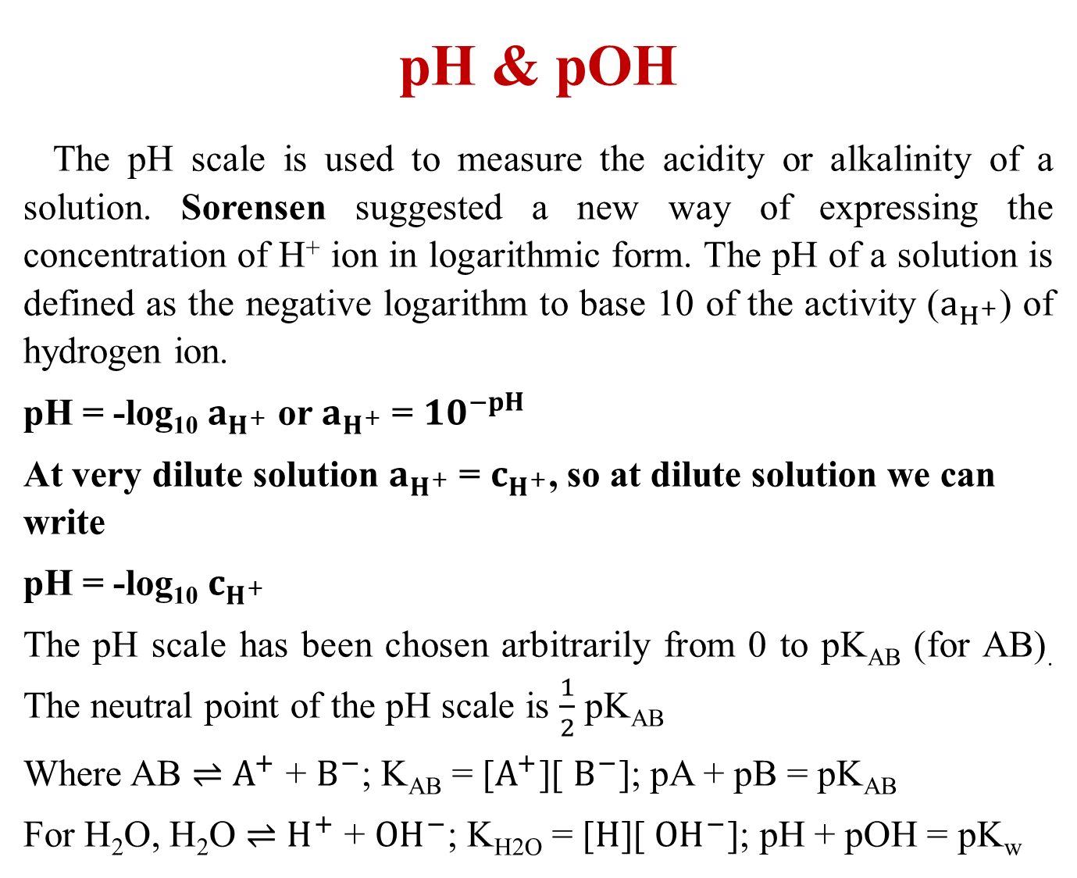
pH & pOH
The pH scale is used to measure the acidity or alkalinity of a solution. Sorensen suggested a new way of expressing the concentration of H⁺ ion in logarithmic form. The pH of a solution is defined as the negative logarithm to base 10 of the activity ($a_{H^{+}}$) of hydrogen ion.
pH = -log₁₀ $a_{H^{+}}$ or $a_{H^{+}}$ = ${10}^{−pH}$
At very dilute solution $a_{H^{+}}$ = $c_{H^{+}}$, so at dilute solution we can write
pH = -log₁₀ $c_{H^{+}}$
The pH scale has been chosen arbitrarily from 0 to pK_{AB} (for AB). The neutral point of the pH scale is $\frac{1}{2}$ pK_{AB}
Where AB $⇌$ $A^{+}$ + $B^{−}$; K_{AB} = [$A^{+}$][ $B^{−}$]; pA + pB = pK_{AB}
For H₂O, H₂O $⇌$ $H^{+}$ + ${OH}^{−}$; K_{H2O} = [$H$][ ${OH}^{−}$]; pH + pOH = pK_{w}

Slide 15
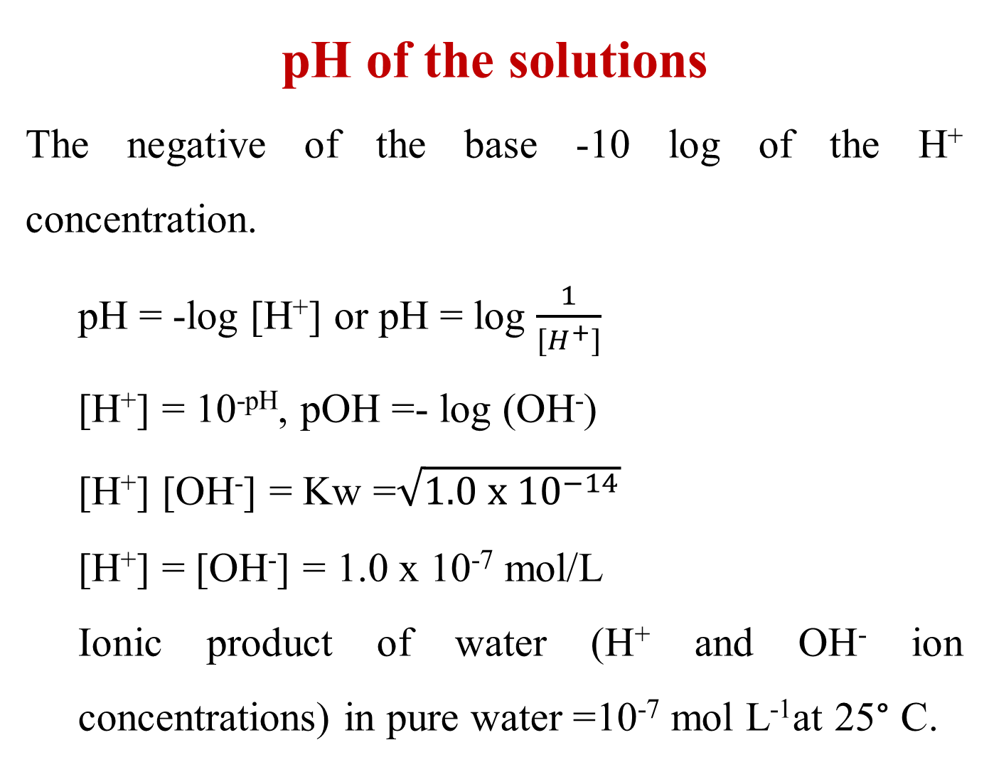
pH of the solutions
The negative of the base -10 log of the H⁺ concentration.
pH = -log [H⁺] or pH = log $\frac{1}{{[H}^{+}]}$
[H⁺] = 10^{-pH}, pOH =- log (OH⁻)
[H⁺] [OH⁻] = Kw =$\sqrt{1.0 x {10}^{−14}}$
[H⁺] = [OH⁻] = 1.0 x 10⁻⁷ mol/L
Ionic product of water (H⁺ and OH⁻ ion concentrations) in pure water =10⁻⁷ mol L⁻¹at 25° C.

Slide 16
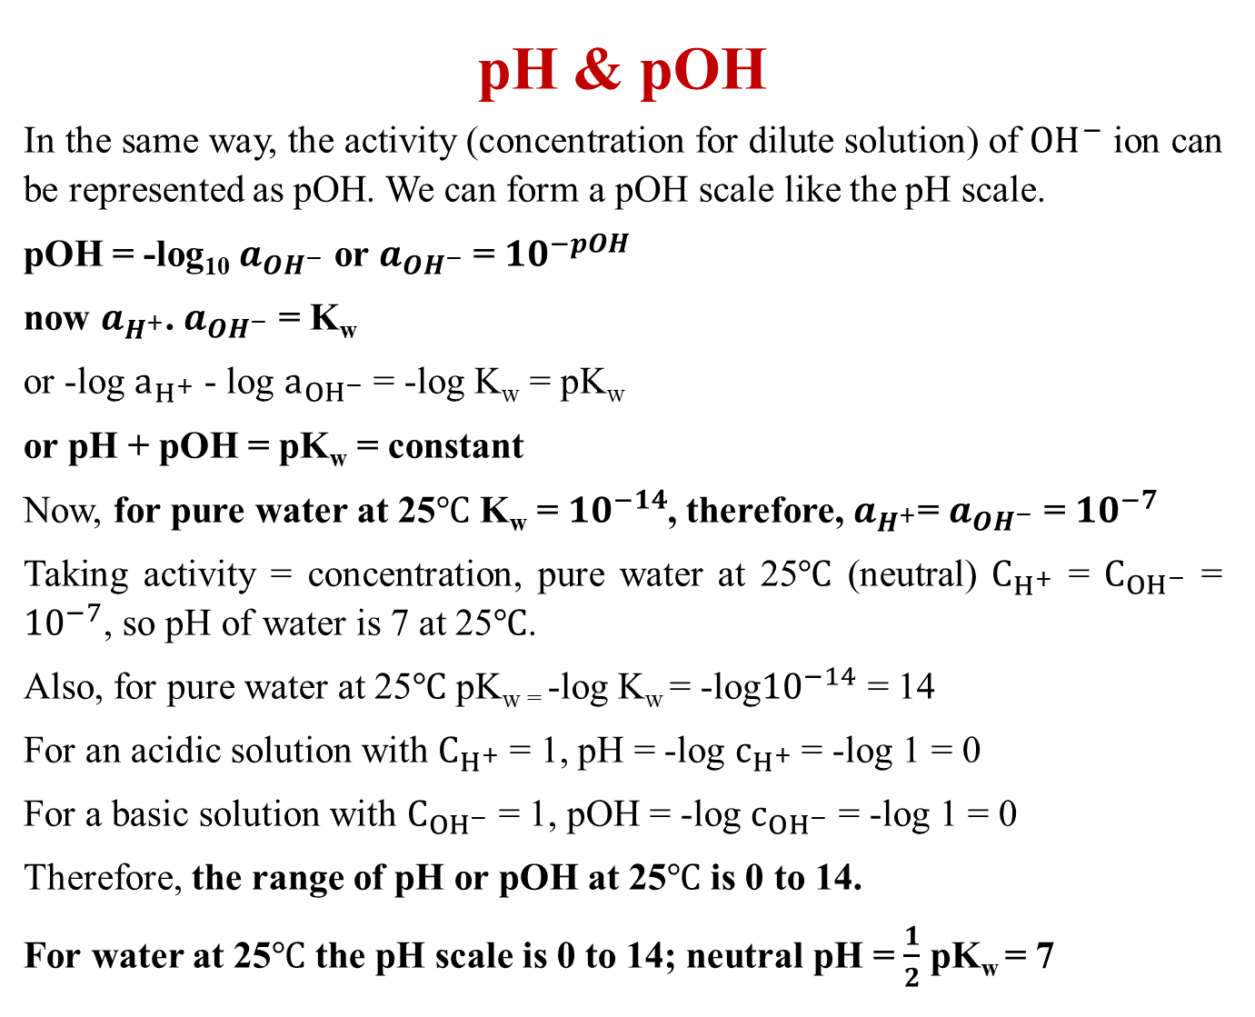
pH & pOH
In the same way, the activity (concentration for dilute solution) of ${OH}^{−}$ ion can be represented as pOH. We can form a pOH scale like the pH scale.
pOH = -log₁₀ $a_{{OH}^{−}}$ or $a_{{OH}^{−}}$ = ${10}^{−pOH}$
now $a_{H^{+}}$. $a_{{OH}^{−}}$ = K_{w}
or -log $a_{H^{+}}$ - log $a_{{OH}^{−}}$ = -log K_{w} = pK_{w}
or pH + pOH = pK_{w} = constant
Now, for pure water at 25$℃$ K_{w} = ${10}^{−14}$, therefore, $a_{H^{+}}$= $a_{{OH}^{−}}$ = ${10}^{−7}$
Taking activity = concentration, pure water at 25$℃$ (neutral) $C_{H^{+}}$ = $C_{{OH}^{−}}$ = ${10}^{−7}$, so pH of water is 7 at 25$℃$.
Also, for pure water at 25$℃$ pK_{w =} -log K_{w} = -log${10}^{−14}$ = 14
For an acidic solution with $C_{H^{+}}$ = 1, pH = -log $c_{H^{+}}$ = -log 1 = 0
For a basic solution with $C_{OH^{−}}$ = 1, pOH = -log $c_{{OH}^{−}}$ = -log 1 = 0
Therefore, the range of pH or pOH at 25$℃$ is 0 to 14.
For water at 25$℃$ the pH scale is 0 to 14; neutral pH = $\frac{1}{2}$ pK_{w} = 7

Slide 17
The pH scale
The pH scale ranges from 1 to 10⁻¹⁴ mol/L or from 1 to 14.
pH = - log [H₃O⁺]
1 2 3 4 5 6 7 8 9 10 11 12 13 14
acid neutral base

Slide 18
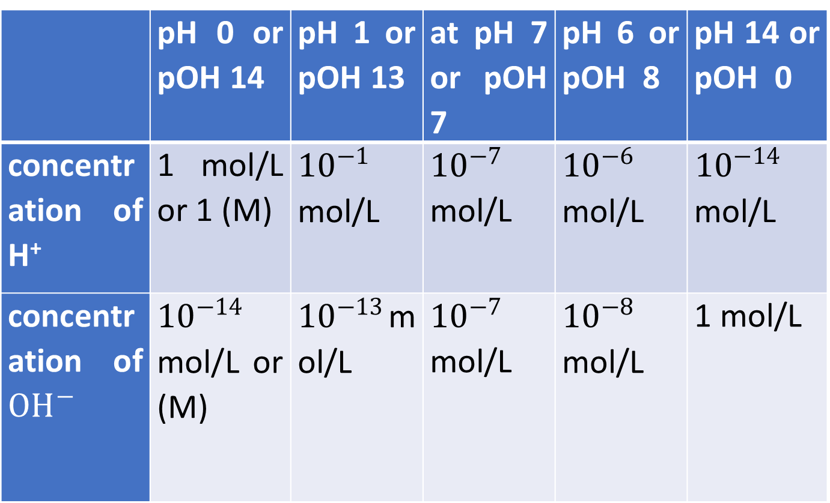

pH & pOH
At 25$℃$ the value of concentration of H⁺ and ${OH}^{−}$ at different pH
 | pH 0 or pOH 14 | pH 1 or pOH 13 | at pH 7 or pOH 7 | pH 6 or pOH 8 | pH 14 or pOH 0
concentration of H⁺ | 1 mol/L or 1 (M) | ${10}^{−1}$ mol/L | ${10}^{−7}$ mol/L | ${10}^{−6}$ mol/L | ${10}^{−14}$ mol/L
concentration of ${OH}^{−}$ | ${10}^{−14}$ mol/L or (M) | ${10}^{−13}$mol/L | ${10}^{−7}$ mol/L | ${10}^{−8}$ mol/L | 1 mol/L

Slide 19
pH of the solutions
At 25° C the range of pH scale is 1 to 7 to 14,
A solution with a pH of 1 has [H₃O⁺] of 0.1 mol/L or 10⁻¹
A solution with a pH of 3 has [H₃O⁺] of 0.001 mol/L or 10⁻³
A solution with a pH of 7 has [H₃O⁺] of 0.0000001 mol/L or 10⁻⁷
With increasing temperature, this range of pH decrease
K_{w} = [H⁺] [OH⁻] = 1.0 x 10⁻¹⁴ (K_{w} = Equilibrium constant for water)
the value of K_{w} is temperature dependent. The value of K_{w} at 25° C is 10⁻¹⁴. When the temperature is increased, the value of [H⁺] and [OH⁻] will increase, so K_{w} will also increase.

Slide 20
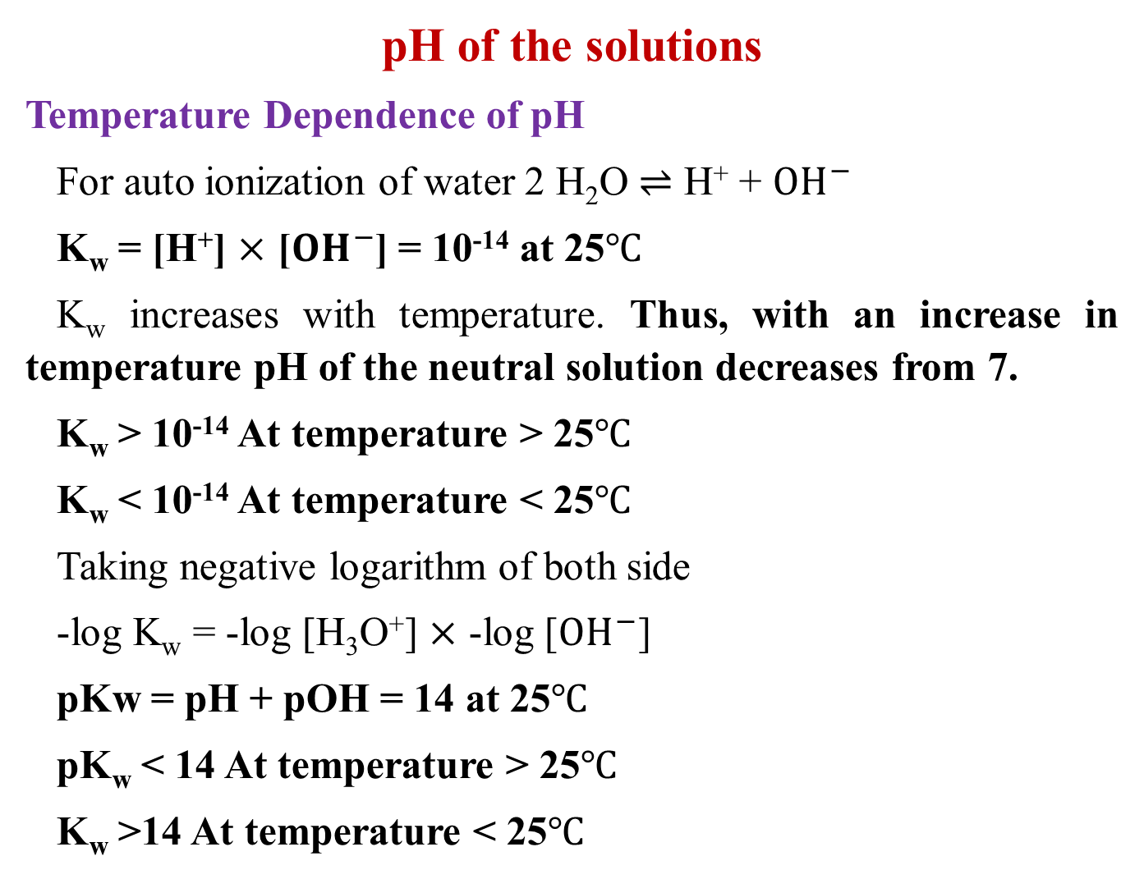
pH of the solutions
Temperature Dependence of pH
For auto ionization of water 2 H₂O $⇌$ H⁺ + ${OH}^{−}$
K_{w} = [H⁺] $×$ [${OH}^{−}$] = 10⁻¹⁴ at 25$℃$
K_{w} increases with temperature. Thus, with an increase in temperature pH of the neutral solution decreases from 7.
K_{w} > 10⁻¹⁴ At temperature > 25$℃$
K_{w} < 10⁻¹⁴ At temperature < 25$℃$
Taking negative logarithm of both side
-log K_{w} = -log [H₃O⁺] $×$ -log [${OH}^{−}$]
pKw = pH + pOH = 14 at 25$℃$
pK_{w} < 14 At temperature > 25$℃$
K_{w} >14 At temperature < 25$℃$

Slide 21
Buffer Solution
A buffer solution is a solution that resists changes in its pH level when a small amount of acid or base is added to it. For example, the pH of 1 litre of water will drop from 7 if 1 ml (N/100) HNO₃ is added into it. However, the pH stays at 7 if the same acid is added to a buffer solution (CH₃COONH₄). Buffer solutions are commonly composed of a weak acid and its corresponding conjugate base, or a weak base and its corresponding conjugate acid. The presence of these conjugate acid-base pairs allows the buffer solution to minimize the impact of added acids or bases on its pH.
Buffer solutions play a crucial role in various chemical and biological processes, as they help maintain a stable environment for reactions to occur. In biological systems, for example, buffers in the blood help regulate the pH to ensure that physiological processes function properly. Buffers are used in laboratories, industries, and various applications where precise control of pH is essential

Slide 22
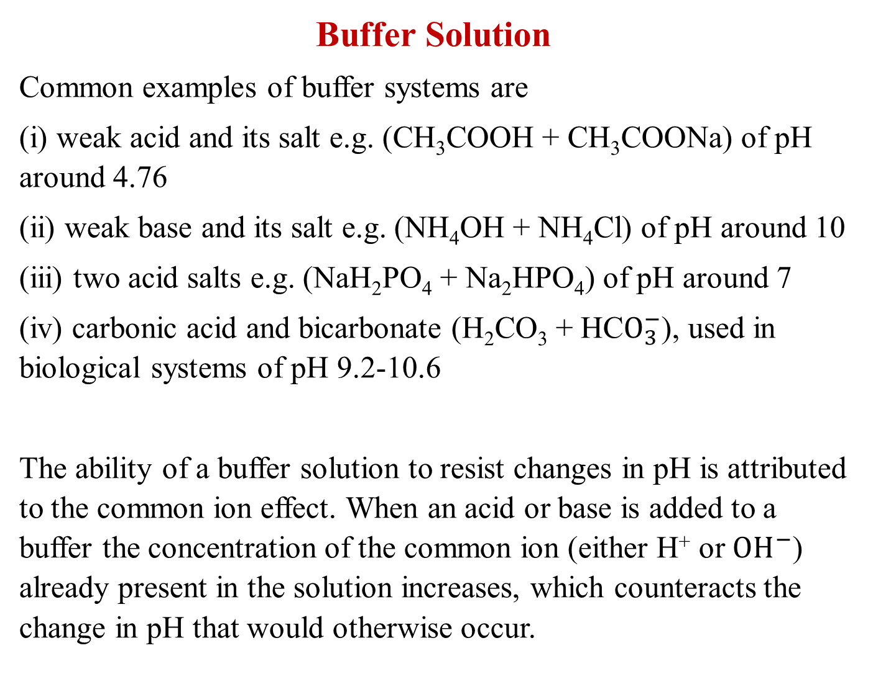
Buffer Solution
Common examples of buffer systems are
(i) weak acid and its salt e.g. (CH₃COOH + CH₃COONa) of pH around 4.76
(ii) weak base and its salt e.g. (NH₄OH + NH₄Cl) of pH around 10
(iii) two acid salts e.g. (NaH₂PO₄ + Na₂HPO₄) of pH around 7
(iv) carbonic acid and bicarbonate (H₂CO₃ + HC$O_{3}^{−}$), used in biological systems of pH 9.2-10.6
The ability of a buffer solution to resist changes in pH is attributed to the common ion effect. When an acid or base is added to a buffer the concentration of the common ion (either H⁺ or ${OH}^{−}$) already present in the solution increases, which counteracts the change in pH that would otherwise occur.

Slide 23
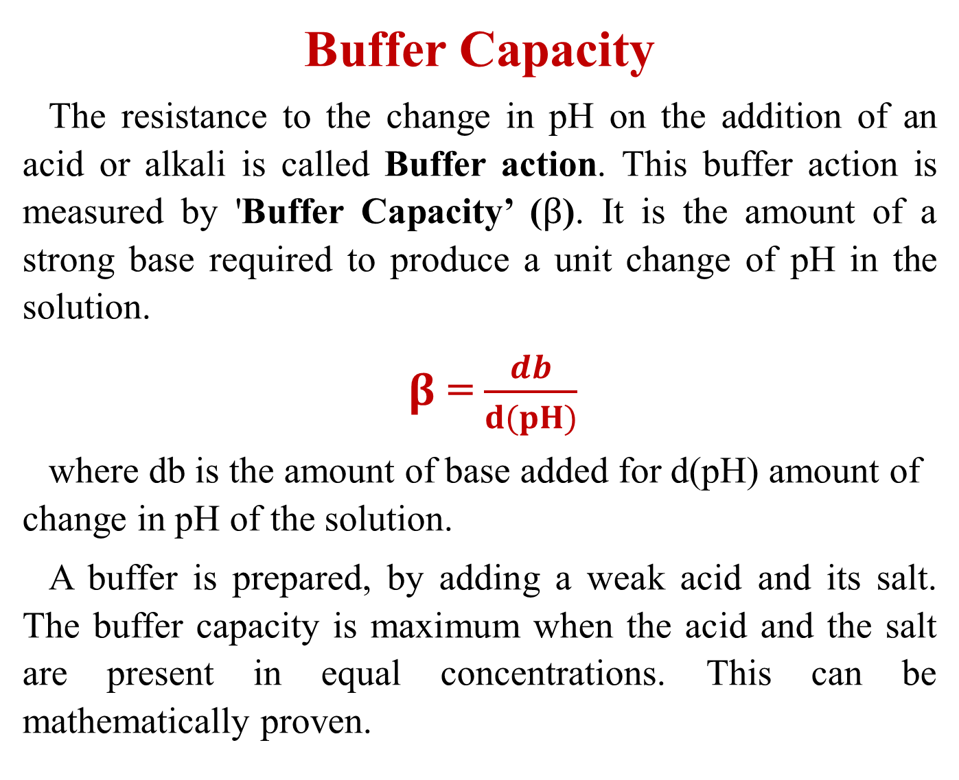
Buffer Capacity
The resistance to the change in pH on the addition of an acid or alkali is called Buffer action. This buffer action is measured by 'Buffer Capacity’ ($β$). It is the amount of a strong base required to produce a unit change of pH in the solution.
$β$ = $\frac{db}{d(pH)}$
where db is the amount of base added for d(pH) amount of change in pH of the solution.
A buffer is prepared, by adding a weak acid and its salt. The buffer capacity is maximum when the acid and the salt are present in equal concentrations. This can be mathematically proven.

Slide 24
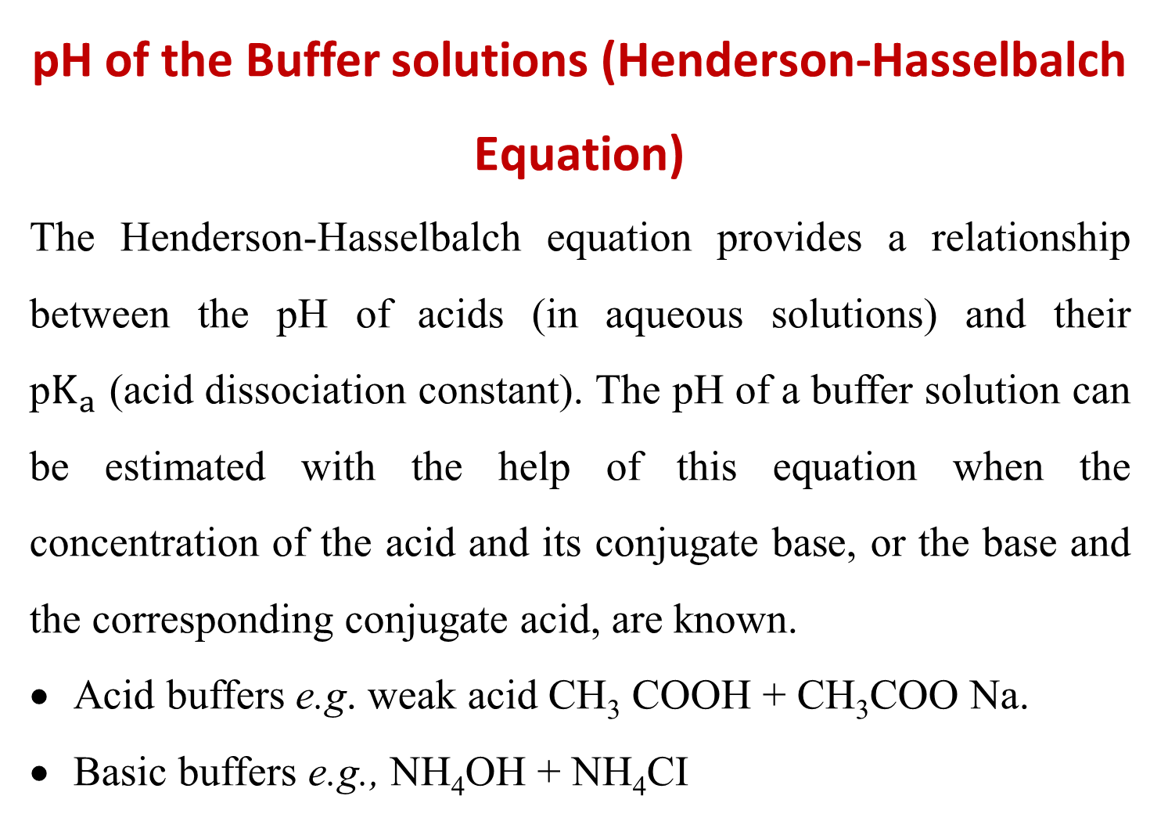
pH of the Buffer solutions (Henderson-Hasselbalch Equation)
The Henderson-Hasselbalch equation provides a relationship between the pH of acids (in aqueous solutions) and their p$K_{a}$ (acid dissociation constant). The pH of a buffer solution can be estimated with the help of this equation when the concentration of the acid and its conjugate base, or the base and the corresponding conjugate acid, are known.
Acid buffers e.g. weak acid CH₃ COOH + CH₃COO Na.
Basic buffers e.g., NH₄OH + NH₄CI

Slide 25
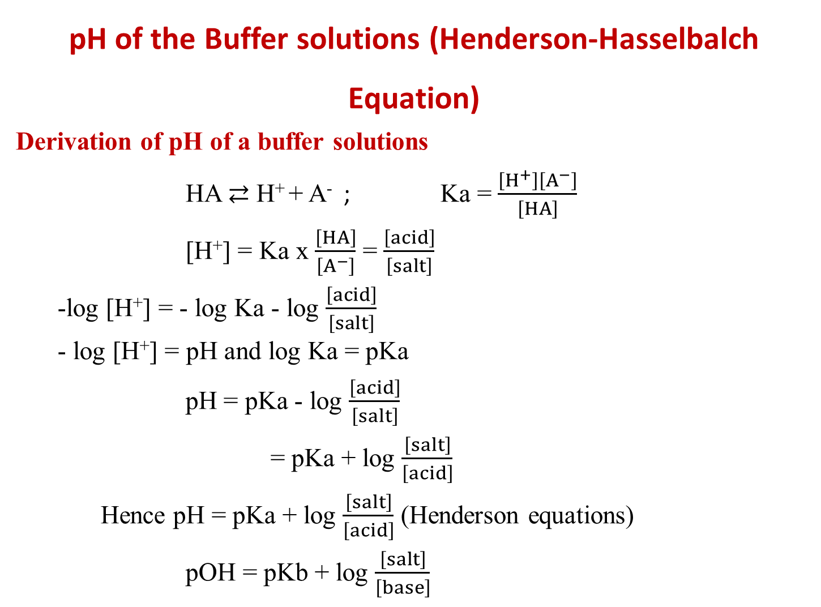
pH of the Buffer solutions (Henderson-Hasselbalch Equation)
Derivation of pH of a buffer solutions
HA $⇄$ H⁺ + A⁻ ; Ka = $\frac{\left[H^{+}\right]\left[A^{−}\right]}{\left[HA\right]}$
[H⁺] = Ka x $\frac{\left[HA\right]}{\left[A^{−}\right]}$ = $\frac{\left[acid\right]}{\left[salt\right]}$
-log [H⁺] = - log Ka - log $\frac{\left[acid\right]}{\left[salt\right]}$
- log [H⁺] = pH and log Ka = pKa
pH = pKa - log $\frac{\left[acid\right]}{\left[salt\right]}$
= pKa + log $\frac{\left[salt\right]}{\left[acid\right]}$
Hence pH = pKa + log $\frac{\left[salt\right]}{\left[acid\right]}$ (Henderson equations)
pOH = pKb + log $\frac{\left[salt\right]}{\left[base\right]}$

Slide 26
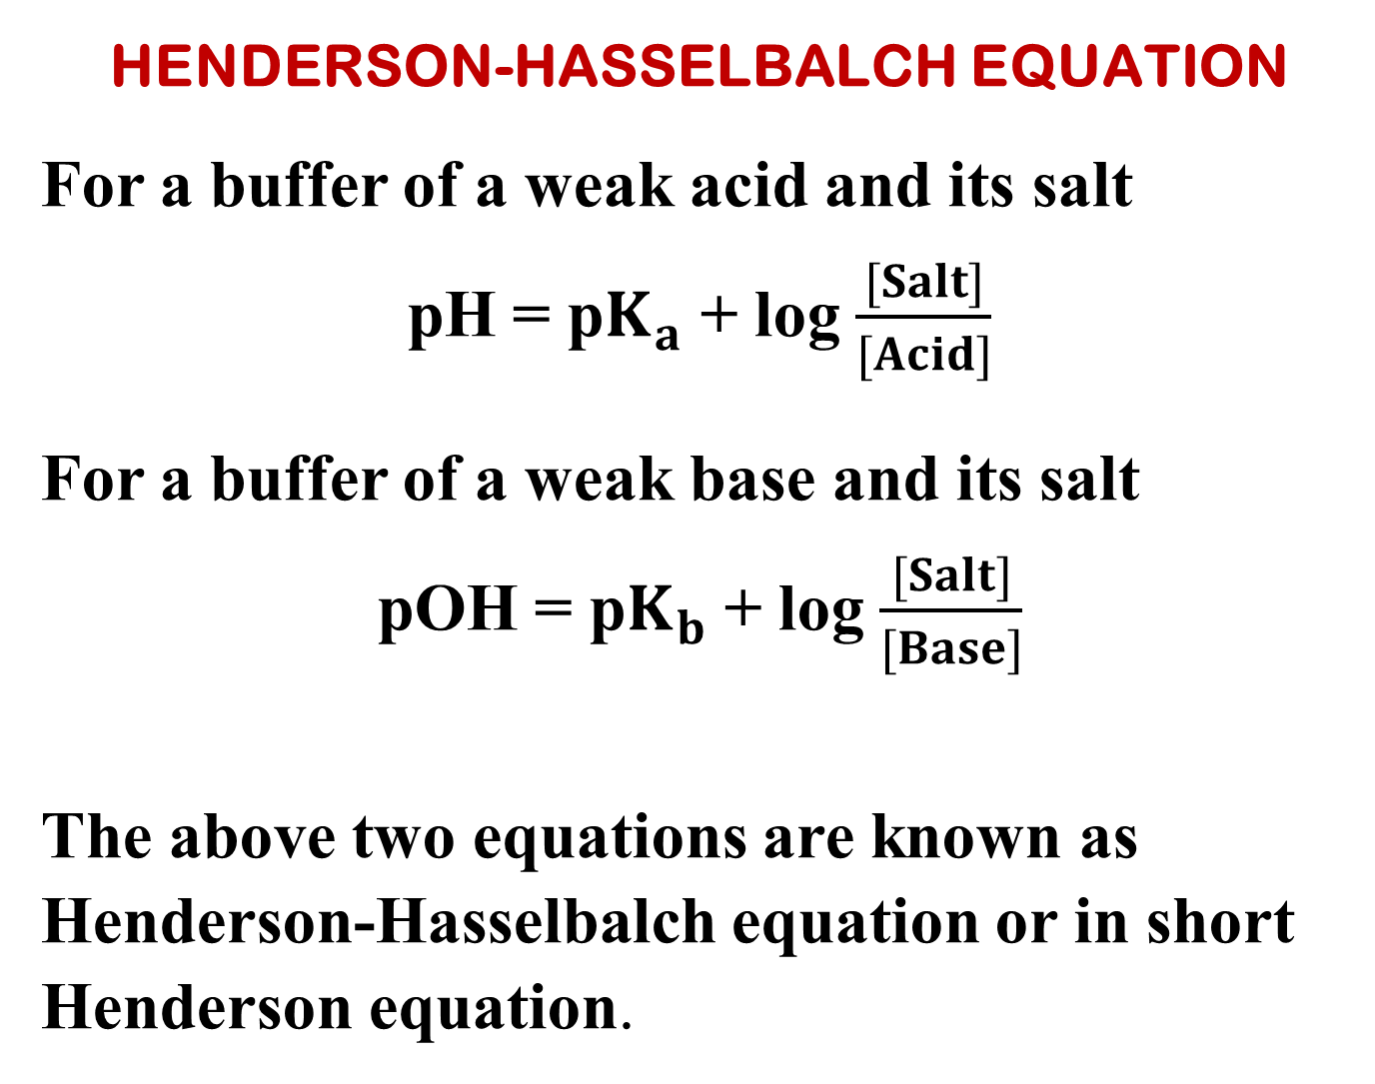
HENDERSON-HASSELBALCH EQUATION
For a buffer of a weak acid and its salt
pH = p$K_{a}$ + log $\frac{[Salt]}{[Acid]}$
For a buffer of a weak base and its salt
pOH = p$K_{b}$ + log $\frac{[Salt]}{[Base]}$
The above two equations are known as Henderson-Hasselbalch equation or in short Henderson equation.

Slide 27
Reference
Ashim K Das , Fundamental Concept of Inorganic Chemistry, CBC Publishers & Distributors, Volume 3, Second Edition: 2010
R.P. Sarkar, General and Inorganic Chemistry Part-1, NCBA (P) Ltd, 3rd Edition 2011
R.L. Dutta, G.S. De, Inorganic Chemistry, Part I, The new Book Stall, 6th Edition2009, 7th Edition 2013
Wahid U. Malik, G. D. Tuli & R. D. Madan, Selected topics in inorganic chemistry, S. Chand & Company Ltd, first edition 1976
J.E. Huheey, E.A. Keiter, R.L. Keiter, Inorganic Chemistry Principles of Structure and Reactivity, Pearson Education Asia, fourth Edition, 2000

Slide 28
Thank you

